Slide 1
Multi-agent pathfinding in Warehouse Automation
Phillip Wong
Daniel Harabor & Pierre Le Bodic
Notes:
Morning / Afternoon ~ Name - Phillip Wong ~ Proj: MAPF ~ Along with 2, Dan, Pierre

Slide 2
Multi-agent pathfinding
Find a path to the goal for all agents
Ensure no conflicts
🙍‍♂️1 |  |  | 🙍‍♂️2
🔑2 |  |  | 🔑1
Notes:
Finding a path for all agent from their location to their goal

Slide 3
Multi-agent pathfinding
🙍‍♂️1 |  |  | 🙍‍♂️2
🔑2 |  |  | 🔑1

Slide 4
Multi-agent pathfinding
🙍‍♂️1 |  | 🙍‍♂️2
🔑2 |  |  | 🔑1

Slide 5
Multi-agent pathfinding
🙍‍♂️1 | 🙍‍♂️2
🔑2 |  |  | 🔑1

Slide 6
Multi-agent pathfinding
🙍‍♂️1
🔑2 | 🙍‍♂️2 |  | 🔑1

Slide 7
Multi-agent pathfinding
 | 🙍‍♂️1
🙍‍♂️2 |  |  | 🔑1

Slide 8
Multi-agent pathfinding
 |  | 🙍‍♂️1
🙍‍♂️2 |  |  | 🔑1

Slide 9
Multi-agent pathfinding
 |  |  | 🙍‍♂️1
🙍‍♂️2 |  |  | 🔑1

Slide 10
Multi-agent pathfinding
🙍‍♂️2 |  |  | 🙍‍♂️1

Slide 11
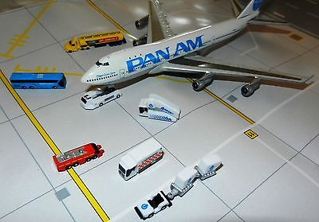
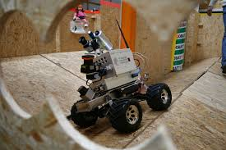
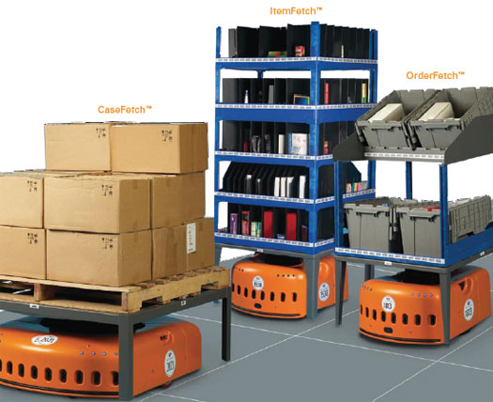
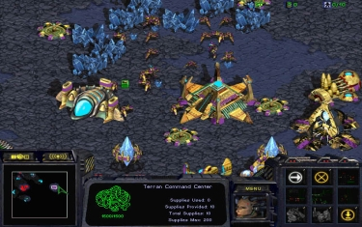
Motivation
Video games
Logistics
Robotics
Warehouse Automation

Slide 12
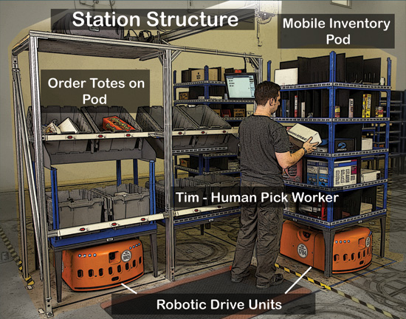
Warehouse Automation
Kiva Systems / Amazon Robotics
Large scale 1000+ robots
Put gif here
Notes:
Order a product from amazon, day arrival => kiva system will * process order * get the required inventory which is located around the warehouse * and packing it into a box

Slide 13
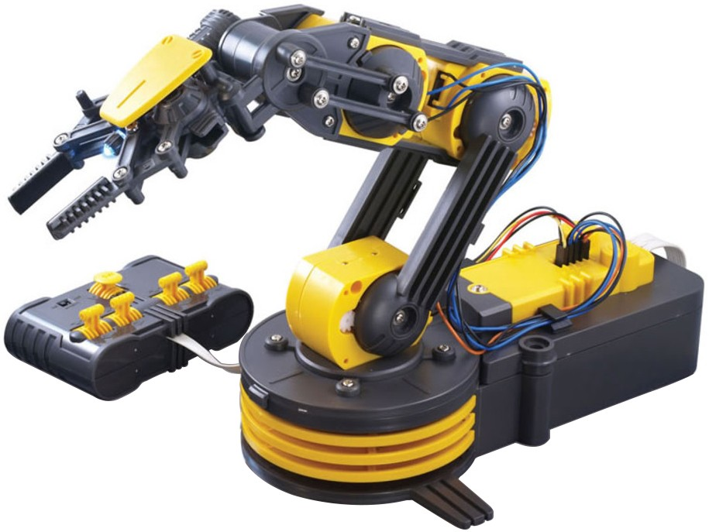


A complex system
Multiagent pathfinding
Replenishment
Robot allocation
Automated Picking
Warehouse Layout
Notes:
Scheduling problem
* Replenishment of parts and battery
* deciding which picking station is free
* drive allocation
Robotics – automated picking
Optimization
* Warehouse layout
MAPF

Slide 14
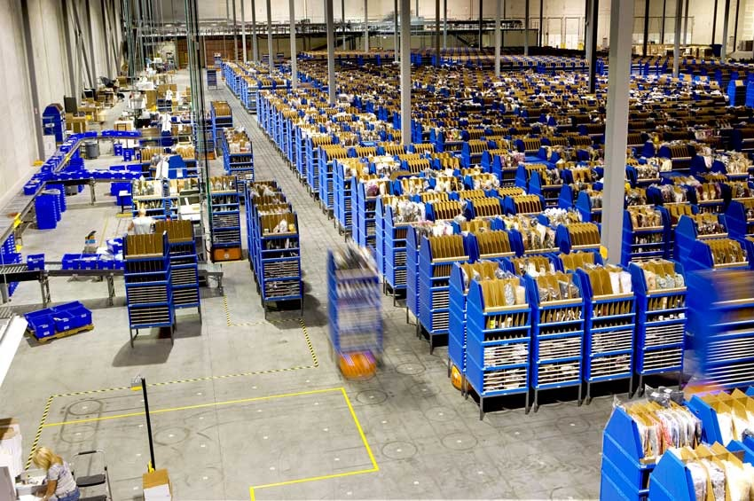
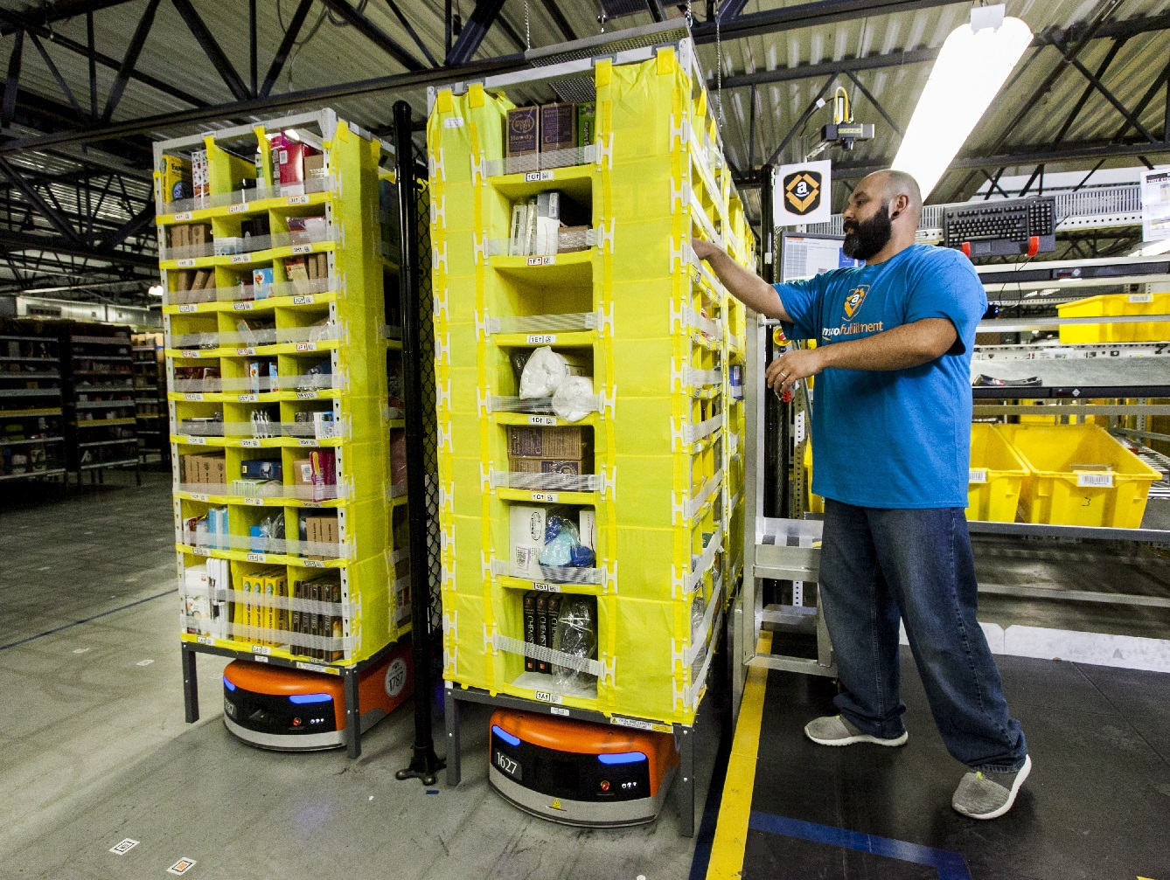
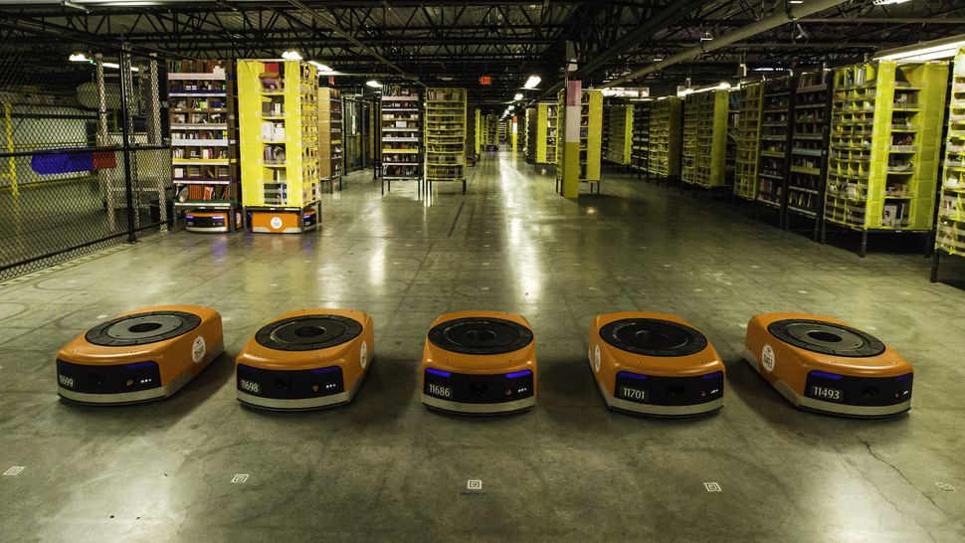
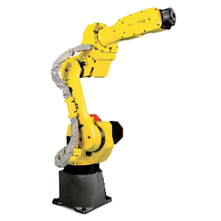
Part-to-picker system
Assign job
Bring ‘part’
Pick and pack

Slide 15
MAPF & part-to-picker system
Assign job
Bring ‘part’
Pick and pack

Slide 16
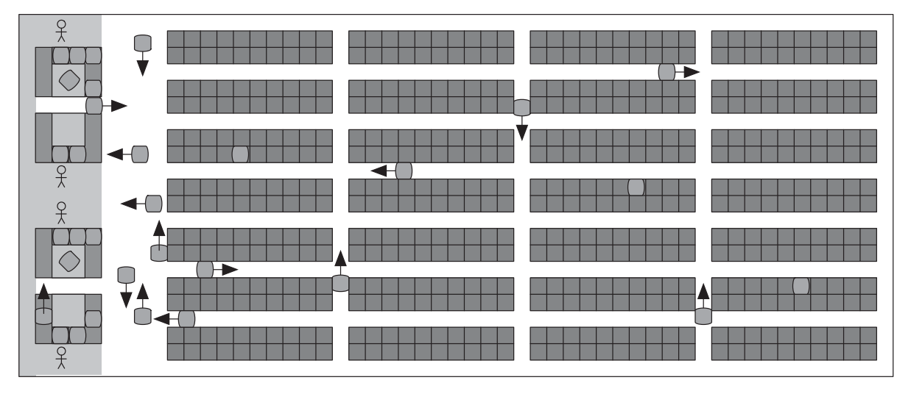
MAPF in Warehouse Automation
Simulation
Orthogonal grid-based map
Objective
Makespan
Down-time
Sum of (distance) cost
Picking Station
Storage Pod Shelving
Drive Unit Agent

Slide 17
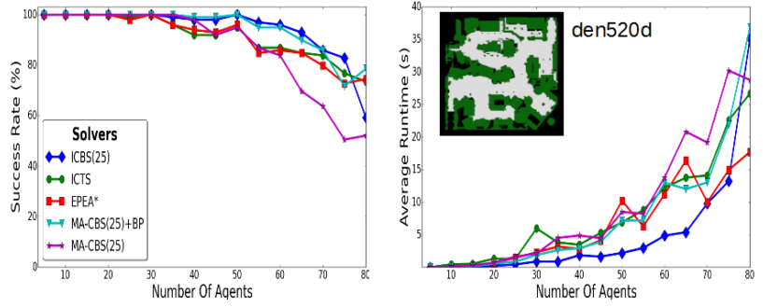
MAPF State of the art
Optimal state of the art
Conflict Based Search (CBS)
~80 robots, 13214 nodes
Success rate
Suboptimal state of the art
2000+ agents, 15899 nodes (FAR)
~30 seconds
TODO: GIF OF WURMAN’S WAREHOUSE SIM
Notes:
Optimality
* Timeout ~5 minutes
Non-optimal:
* 2000+ agents ~30 seconds
* Makespan is really bad!

Slide 18

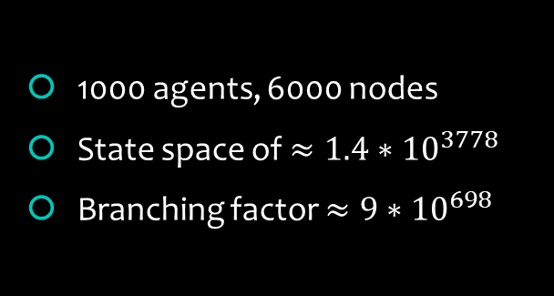
NP-Hard
1000 agents, 6000 nodes
State space of $≈1.4∗{10}^{3778}$
Branching factor ${≈9∗10}^{698}$
$k$ agents, $n$ nodes
$n^{k}$ state space
$5^{k}$ branching factor
15 | 2 | 1 | 12
8 | 5 | 6 | 11
4 | 9 | 10 | 7
3 | 14 | 13
1 | 2 | 3 | 4
5 | 6 | 7 | 8
9 | 10 | 11 | 12
13 | 14 | 15
Notes:
State space: ways to place agents on the grid
5 actions {up down left right wait}

Slide 19
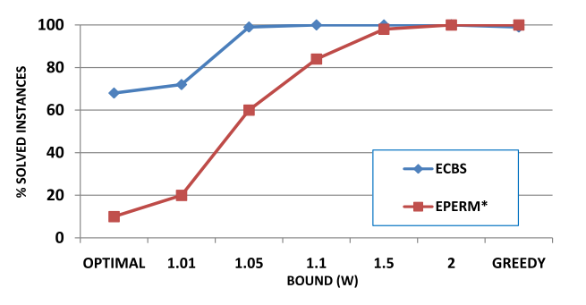
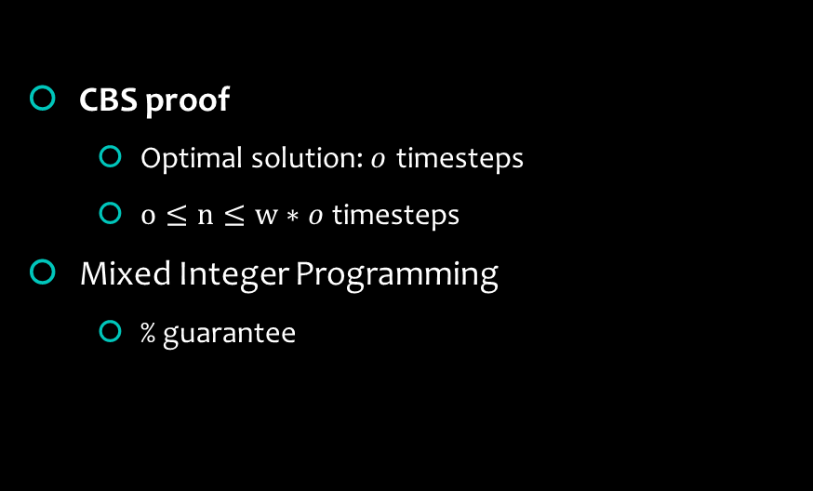
Why optimality?
Bounded suboptimal solution
CBS proof
Optimal solution:$o$ timesteps
$o≤n≤w∗o$timesteps
Mixed Integer Programming
% guarantee
Notes:
Better starting point!

Slide 20
Example
Perform Search
Find Conflicts
Resolve Conflicts
Cons:
1
2
3
 |  |  | 🔑2
🙍‍♂️2 |  |  | 🔑1
 | 🙍‍♂️1
1 2 3 4
Notes:
Here we have another example of A1 and A2 moving to their goals.
LHS we have the search tree.
The top right corner shows the process behind CBS

Slide 21
Perform Search
Perform Search
Find Conflicts
Resolve Conflicts
Cons:
Cost: 7
1
2
3
 |  |  | 🔑2
🙍‍♂️2 |  |  | 🔑1
 | 🙍‍♂️1
1 2 3 4
Notes:
So first we perform the search and update the cost of this solution in our tree.
So this is 7 which is the summing the distances of A1 and A2’s paths

Slide 22
Find conflicts
Perform Search
Find Conflicts
Resolve Conflicts
Cons:
Cost: 7
1
2
3
 |  |  | 🔑2
🙍‍♂️2 |  |  | 🔑1
 | 🙍‍♂️1
1 2 3 4
Notes:
Here we have a collision between A1 and A2 at (2,2).
Essentially CBS branches at every collision, that is we have two options here: A1 should give way and avoid (2,2) or A2 should give way and avoid (2,2)

Slide 23
Resolve Conflicts
Perform Search
Find Conflicts
Resolve Conflicts
Cons:
Cost: 7
Cons: {🙍‍♂️1, (2,2), 1}
Cons: {🙍‍♂️2, (2,2), 1}
1
2
3
 |  |  | 🔑2
🙍‍♂️2 |  |  | 🔑1
 | 🙍‍♂️1
1 2 3 4
Notes:
And here is it, A1 should not be at (2, 2) at timestep 1
OR A2 should not be at (2, 2) at timestep 1

Slide 24
Perform Search
Perform Search
Find Conflicts
Resolve Conflicts
Cons:
Cost: 7
Cons: {🙍‍♂️1, (2,2), 1}
Cost: 7
Cons: {🙍‍♂️2, (2,2), 1}
Cost: 8
1
2
3
 |  |  | 🔑2
🙍‍♂️2 |  |  | 🔑1
 | 🙍‍♂️1
1 2 3 4
Notes:
Find a path for each branch
Identify conflicts between paths
Perform search again, reduce the number of conflicts

Slide 25
Find Conflicts
Perform Search
Find Conflicts
Resolve Conflicts
Cons:
Cost: 7
Cons: {🙍‍♂️1, (2,2), 1}
Cost: 7
Cons: {🙍‍♂️2, (2,2), 1}
Cost: 8
1
2
3
 |  |  | 🔑2
🙍‍♂️2 |  |  | 🔑1
 | 🙍‍♂️1
1 2 3 4
Notes:
Find a path for each agent
Identify conflicts between paths
Perform search again, reduce the number of conflicts

Slide 26
Resolve Conflicts
Perform Search
Find Conflicts
Resolve Conflicts
Cons:
Cost: 7
Cons: {🙍‍♂️1, (2,2), 1}
Cost: 7
Cons: {🙍‍♂️2, (2,2), 1}
Cost: 8
Cons: {🙍‍♂️1, (2,2), 1}
Cons: {🙍‍♂️1, (3,2), 2}
Cost: 7
Cons: {🙍‍♂️1, (2,2), 1}
Cons: {🙍‍♂️2, (3,2), 2}
Cost: 7
1
2
3
 |  |  | 🔑2
🙍‍♂️2 |  |  | 🔑1
 | 🙍‍♂️1
1 2 3 4
Notes:
Find a path for each agent
Identify conflicts between paths
Perform search again, reduce the number of conflicts

Slide 27
Perform Search
Perform Search
Find Conflicts
Resolve Conflicts
Cons:
Cost: 7
Cons: {🙍‍♂️1, (2,2), 1}
Cost: 7
Cons: {🙍‍♂️2, (2,2), 1}
Cost: 8
Cons: {🙍‍♂️1, (2,2), 1}
Cons: {🙍‍♂️1, (3,2), 2}
Cost: 7
Cons: {🙍‍♂️1, (2,2), 1}
Cons: {🙍‍♂️2, (3,2), 2}
Cost: 7
1
2
3
 |  |  | 🔑2
🙍‍♂️2 |  |  | 🔑1
 | 🙍‍♂️1
1 2 3 4
Notes:
Find a path for each agent
Identify conflicts between paths
Perform search again, reduce the number of conflicts

Slide 28
Find Conflicts
Perform Search
Find Conflicts
Resolve Conflicts
Cons:
Cost: 7
Cons: {🙍‍♂️1, (2,2), 1}
Cost: 7
Cons: {🙍‍♂️2, (2,2), 1}
Cost: 8
Cons: {🙍‍♂️1, (2,2), 1}
Cons: {🙍‍♂️1, (3,2), 2}
Cost: 7
Cons: {🙍‍♂️1, (2,2), 1}
Cons: {🙍‍♂️2, (3,2), 2}
Cost: 7
1
2
3
 |  |  | 🔑2
🙍‍♂️2 |  |  | 🔑1
 | 🙍‍♂️1
1 2 3 4
Notes:
Find a path for each agent
Identify conflicts between paths
Perform search again, reduce the number of conflicts

Slide 29
Our approach
Mixed Integer Programming

Slide 30

Model
Run Solver
Output
minimize x + y
subject to
x > 2
y < 5
x, y >= 0
x = 3
y = 0
SCIP

Slide 31
Example 2 – Mixed Integer Programming
 |  |  | 🔑2
🙍‍♂️2 |  |  | 🔑1
 | 🙍‍♂️1

Slide 32
Example 2 – Mixed Integer Programming
 |  |  | 🔑2
🙍‍♂️2 |  |  | 🔑1
 | 🙍‍♂️1
M = 10 // estimated maximum path distance
minimize 3p1 + 4p2 + Mq1 + Mq2
subject to
p1 + q1 = 1
p2 + q2 = 1
p1 + p2 <= 1
p1, p2, q1, q2 >= 0
LP solution: p1 = 1, q2 = 1
Notes:
P’s statnd for paths. The 3 and 4 are the path length.
Q’s are a penalty As you can see these have high cost attached to them, choosing this means that we failed to find a successful path.
This set of constraints ensures that you either pick the path p1, or the penalty
This says that there is a collision between path’s p1 and p2.
And we ensures that none of the values are negative.
So feeding this into the solver, we see that we get the solution p1, q2 that is we get a sum of 13

Slide 33
Example 2 – Mixed Integer Programming
 |  |  | 🔑2
🙍‍♂️2 |  |  | 🔑1
 | 🙍‍♂️1
M = 10 // estimated maximum path distance
minimize 3p1 + 3p1’ + 4p2 + 4p2’ + Mq1 + Mq1’ + Mq2 + Mq2’
subject to
p1 + q1 = 1
p2 + q2 = 1
p1’ + q1’ = 1
p2’ + q2’ = 1
p1 + p1’ = 1
p2 + p2’ = 1
p1 + p2 + p2’ <= 1
p1 + p2 + p1’ <= 1
p1,p2,p1’,p2’,q1,q2,q1’,q2’ >= 0
LP solution: p1’ = 1, q2’ = 1

Slide 34
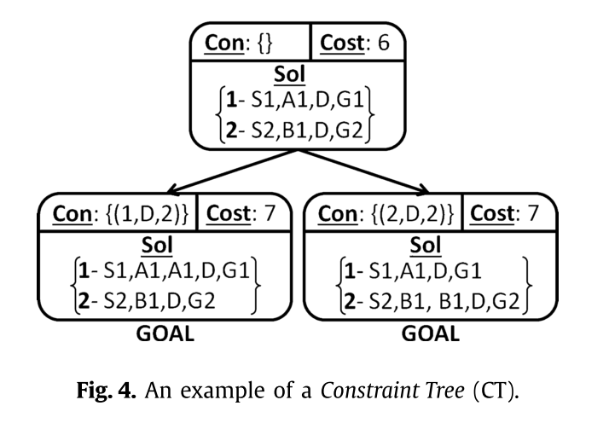
Benefits over CBS
No branching (in this example)
CBS exponential
Solver
minimize x + y
subject to
x > 2
y < 5
x, y >= 0
Notes:
There is no branching! This is the main benefit over CBS.
Well, there are cases where MIP will branch, these are when the solver will give us a fractional value. So it may say take half of this p1 and half of p2 which is not possible.
So in these cases will branch and choose either p1 or p2.
So in general MIP will penalize conflicts and we will feed it whereas
CBS will branch on conflicts. The fact that CBS branches means it is exponential in the number of conflicts!
Moreover it is a different approach, we just need to

Slide 35
Mixed Integer programming
Branch and bound
Highly optimized solvers
minimize 5x + 10y
subject to
0 >= x > 3
0 >= y < 5

Slide 36
Simulation
Warehouse Simulation
Basic framework
Single-agent search

Slide 37
Future Work
Learning Mixed Integer Programming
Improving the simulation
Bug fixes

Slide 38
Expected outcomes
More efficient
Satisfy demand
Fleet size reduced => Complexity
Bounded-suboptimal solution
Notes:
We expect better performance, to warehouses less robots required to Fleet sized reduced.
In order to scale we expect to need a bounded-suboptimal solution

Slide 39
Conclusion
Optimality is a hard problem
Improve state of the art (CBS)
Notes:
Optimality is a hard problem and not feasible in most large or realtime applications. But it is important in order to get a bounded sub-optimal solution, then we can have guarantees on the solution quality.
We think our approach will improve on the state of the art which is Conflict based search. Main point is that CBS branches, our solution will not branch most of the time!

Slide 40
Thanks! Questions?

